Slide 1
CAD
Knot vector generation
Interpolation with B-splines
NURBS

Slide 2
Knot vector generation
  Given
    Data points
    Order/degree of basis functions
    Knot vector
  A B-spline curve can be computed
To be specified by the user
To be specified by the user
To be specified by the user ?
Can we avoid knot vector specification ?
Can we automate knot vector generation ?

Slide 3
Parameterization
  Given data points
    We can determine some parameter spacing
    The interval used may be normalized
    We can extract knots from this spacing
    n+1 data points mean n+1 parameter values
  This may not be a unique way of knot vector determination

Slide 4
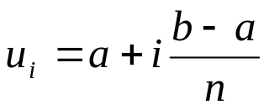
Uniform parameterization
Parameters at equal spacing can be generated
equally spaced n+1 parameters in [a, b]
i = 0, …, n
straightforward
Do not represent relative placement of data points

Slide 5


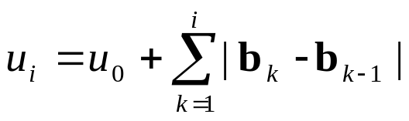
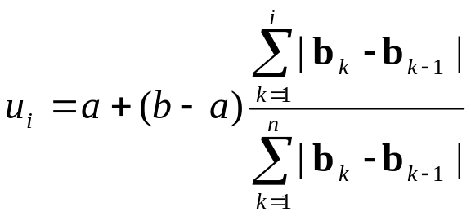
Chord length parameterization
Parameters representing relative placement of data points
can be generated
n+1 parameters placed proportional to the chord lengths of the control polyline
u₃
6
u₂
Y(t)
i = 1, …, n
u₁
u₀
to set parameterization in [a, b]
0
8
X(t)

Slide 6
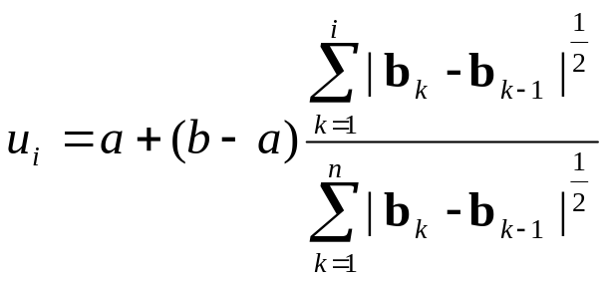
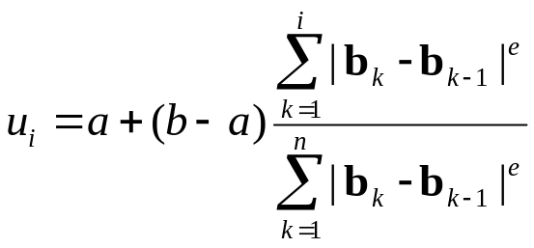
Centripetal & General parameterization
6
the centripetal acceleration should not be too
large at sharp turns (smaller radii of curvature)
in domain [a, b]
Y(t)
0
8
i = 1, …, n
X(t)
e = 0: uniformly spaced
e = 1: chord length parameterization
e = 1/2: centripetal parameterization
i = 1, …, n

Slide 7
Knot vector generation
Given the number of data points: n + 1
the order of basis splines: p
the number of knots to be used is: m+1 = n+1+p
We can use n + 1 parameter values u_{i} to find some or all m + 1
knots t_{i}
Depends on end conditions of the spline
unclamped
Clamped at one end
Clamped at both ends

Slide 8
Knot vector generation
Unclamped splines
all m+1 = n + p +1 knots are simple
n+1 knots (t_{p}, …, t_{n+p}) may be chosen as the parameters, u_{i}, i = 0, …, n
remaining first p knots (t₀, …, t_{p-1}) can be chosen freely
Splines clamped at one end
the knot corresponding to that end must be repeated at least p–1 times
e.g. first end clamped
t₁ = …= t_{p-1}
Free choices
t_{i+p} = u_{i}, i = 0,…, n
t₀ is a free choice
t₀ = t₁
last end clamped
t_{i} = u_{i}, i = 0, …, n
t_{n+ 1} = …= t_{n+p} are free choices

Slide 9
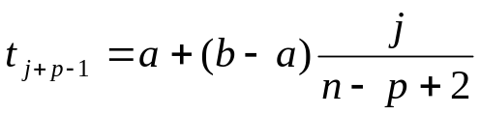
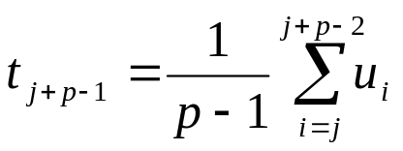
Knot vector generation
Splines clamped at both ends
knots t_{p-1} and t_{m-p+1}, limits of full support range, may each be repeated p times
t₀ = …= t_{p-1} and t_{n+1} = …= t_{n+p}
2p knots determined
remaining n–p+1 internal knots t_{p}, …, t_{n}
may be determined as follows
Evenly spaced internal knots in [a, b]
t₀ = t₁ = …= t_{p-1} = a
j = 1, 2,…, n – p+1
t_{n+1} = t_{n+2} = …= t_{n+p} = b
Do not need the knowledge of control points, simple to generate
Internal knots averaged w.r.t parameters
j = 1, 2,…, n – p+1
t_{p} is the average of u₁, u₂, ..., u_{p-1}
t_{p+1} is the average of u₂, u₃, ..., u_{p}
…

Slide 10
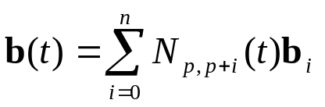
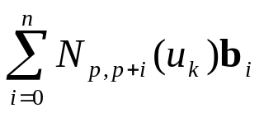
Interpolation with B-spline curves
Given n+1 data points p₀, p₁, ..., p_{n}
n + 1 conditions
fit them with a B-spline curve of given order p ≤ n
a set of parameters u₀, u₁, ..., u_{n} may be generated
the number of knots m + 1 may be computed
knot vector [t₀, t₁, …, t_{m}] may then be computed
Basis functions known
Required to find the B-spline curve
Control points b_{i}’s are (n+1) unknowns
Consider
p_{k} = b(u_{k}) =
k = 0, …, n
p₀
p₁
p₂
…
p_{n}
N_{p,p}(u₀) N_{p,p+1}(u₀) N_{p,p+2}(u₀) … N_{p,n+p}(u₀)
N_{p,p}(u₁) N_{p,p+1}(u₁) N_{p,p+2}(u₁) … N_{p,n+p}(u₁)
N_{p,p}(u₂) N_{p,p+1}(u₂) N_{p,p+2}(u₂) … N_{p,n+p}(u₂)
… … … … …
N_{p,p}(u_{n}) N_{p,p+1}(u_{n}) N_{p,p+2}(u_{n}) … N_{p,n+p}(u_{n})
b₀
b₁
b₂
…
b_{n}
P =
=
= NB

Slide 11
Example
Interpolate data points, (0, 0), (0, 1), (2, 3), (2.5, 6), (5, 2), (6, 0) and (7, −3),
using a B-spline curve with piecewise cubic polynomial segments
Compute distances between successive data points:
d₁ = √(1² + 0²) = 1
d₂ = √(2² + 2²) = 2.83
d₃ = √(0.5² + 3²) = 3.04
d₄ = √(2.5² + 4²) = 4.72
d₅ = √(1² + 2²) = 2.24
d₆ = √(1² + 3²) = 3.16
0.69 | –5.90
–0.20 | 1.74
2.80 | 2.38
1.92 | 8.32
4.77 | 2.34
6.13 | –0.10
8.86 | –8.46
B =
Sum of distances L = 17
Set u₀ = 0
u₁ = u₀ + d₁/L = 0.058 u₄ = u₃ + d₄/L = 0.682
u₂ = u₁ + d₂/L = 0.225 u₅ = u₄ + d₅/L = 0.814
u₃ = u₂ + d₃/L = 0.404 u₆ = u₅ + d₆/L = 1.000
[t₀, …, t_{m}] ≡ [–2, –1, 0, 0.058, 0.225, 0.404, 0.682, 0.814, 1, 2, 3]

Slide 12
Example
10
Plot for t ∈ [0, 1)
Interval of full support
[0.058, 0.814)
-10
-2
10

Slide 13
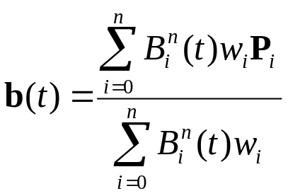
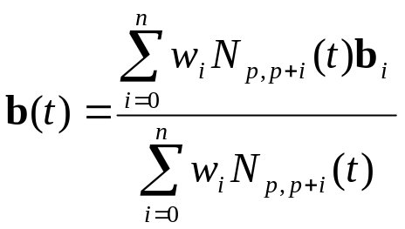
NURBS
Short for Non-Uniform Rational B-Splines
Recall from Rational Bézier curves that
Likewise, NURBS can be computed as
weights w_{i} specified by the user to gain
additional design freedom
non-uniform: knots are not placed at regular intervals
w_{i} = 0: location of b_{i} does not affect the curve’s shape
For larger values of w_{i}, the curve gets pushed towards b_{i}
Offer great flexibility in design
Possess local shape control & all other
Properties of B-spline curves
Widely used in freeform curve design
Can also model analytical curves

Slide 14
Example
For data points (0, 0), (0, 1), (2, 3), (2.5, 6), (5, 2), (6, 0) and (7, −3),
design NURBS with basis functions of order 4. First set all weights to 1.
Increase the weight w₃ corresponding to (2.5, 6) to visualize the shape change
6
2
1
10
w₃ = 0
Knot vector
[0, 1, 2, …, 10)
-4
0
8

Slide 15
Example
6
2
1
10
w₃ = 0
Knot vector
[0, 3, 3, 3, 4,
5, 6, 7, 7, 7,
10)
-4
0
8

